Slide 1
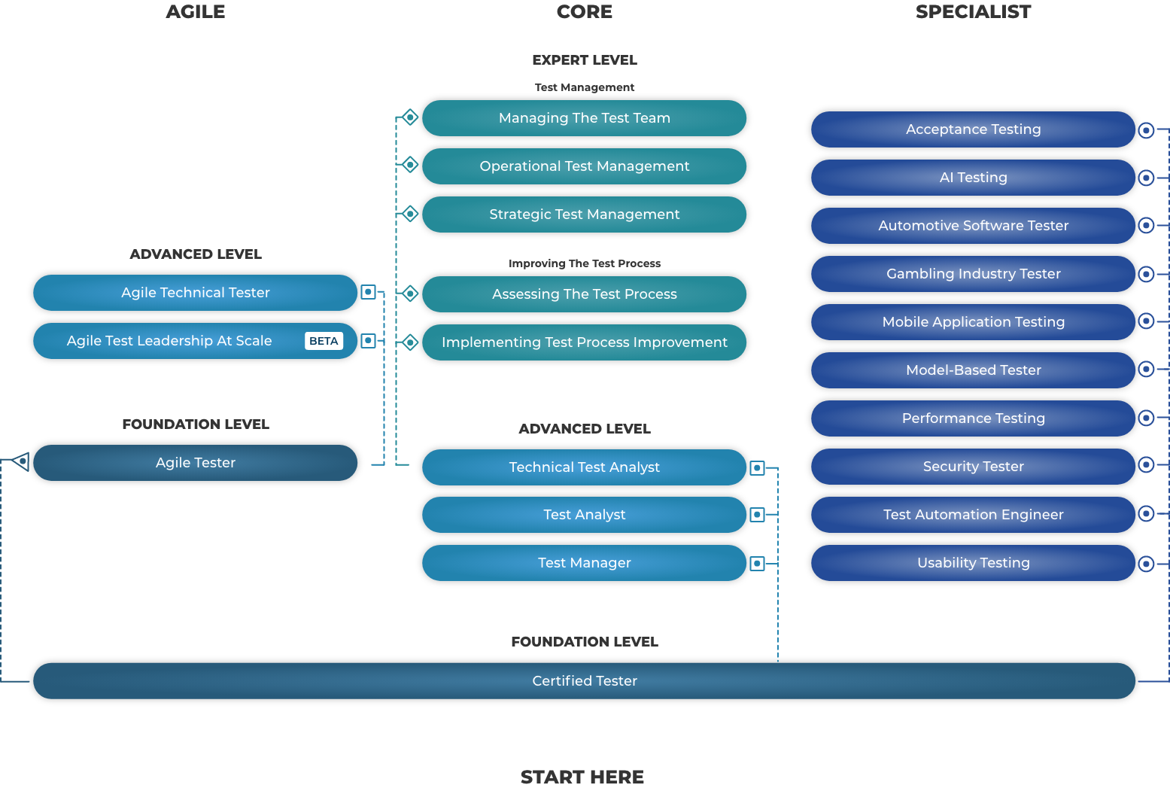
ISTQB Certified Tester Scheme

